Slide 1
Name: Taha Shabbir Lokhandwala
Internship: Ethical Hacking
Title: All given projects

Slide 2
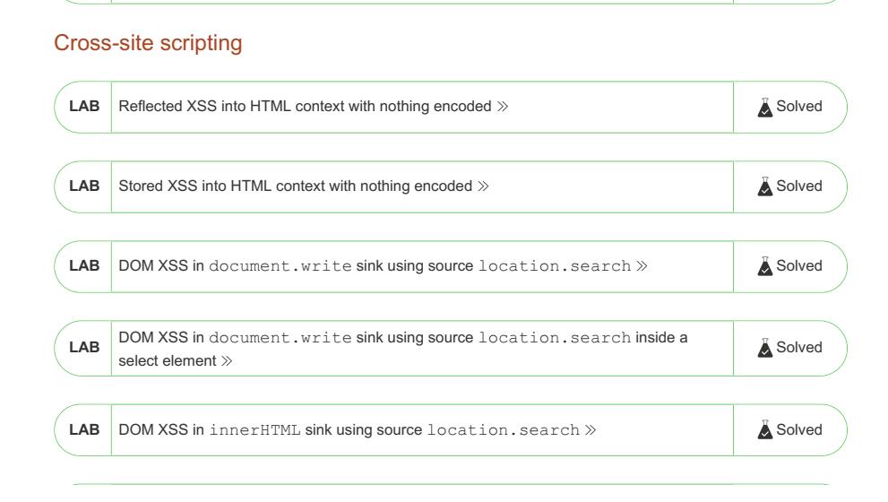
Task 1:

Slide 3
Task 2:
Mentioned Below are some of the vulnerabilities I found using nikto tool in Kali Linux.
- Nikto v2.1.6/2.1.5
+ Target Host: zero.webappsecurity.com
+ Target Port: 80
+ GET Retrieved access-control-allow-origin header: *
+ GET The anti-clickjacking X-Frame-Options header is not present.
+ GET The X-XSS-Protection header is not defined. This header can hint to the user agent to protect against some forms of XSS
+ GET The X-Content-Type-Options header is not set. This could allow the user agent to render the content of the site in a different fashion to the MIME type
+ OPTIONS Allowed HTTP Methods: GET, HEAD, POST, PUT, DELETE, TRACE, OPTIONS, PATCH
+ OSVDB-397: GET HTTP method ('Allow' Header): 'PUT' method could allow clients to save files on the web server.
+ OSVDB-5646: GET HTTP method ('Allow' Header): 'DELETE' may allow clients to remove files on the web server.

Slide 4
+ GET HTTP method: 'PATCH' may allow client to issue patch commands to server. See RFC-5789.
+ OSVDB-561: GET /server-status: This reveals Apache information. Comment out appropriate line in the Apache conf file or restrict access to allowed sources.
+ OSVDB-3092: GET /admin/: This might be interesting...
+ GET Uncommon header 'content-disposition' found, with contents: attachment; filename="readme.txt"

Slide 5
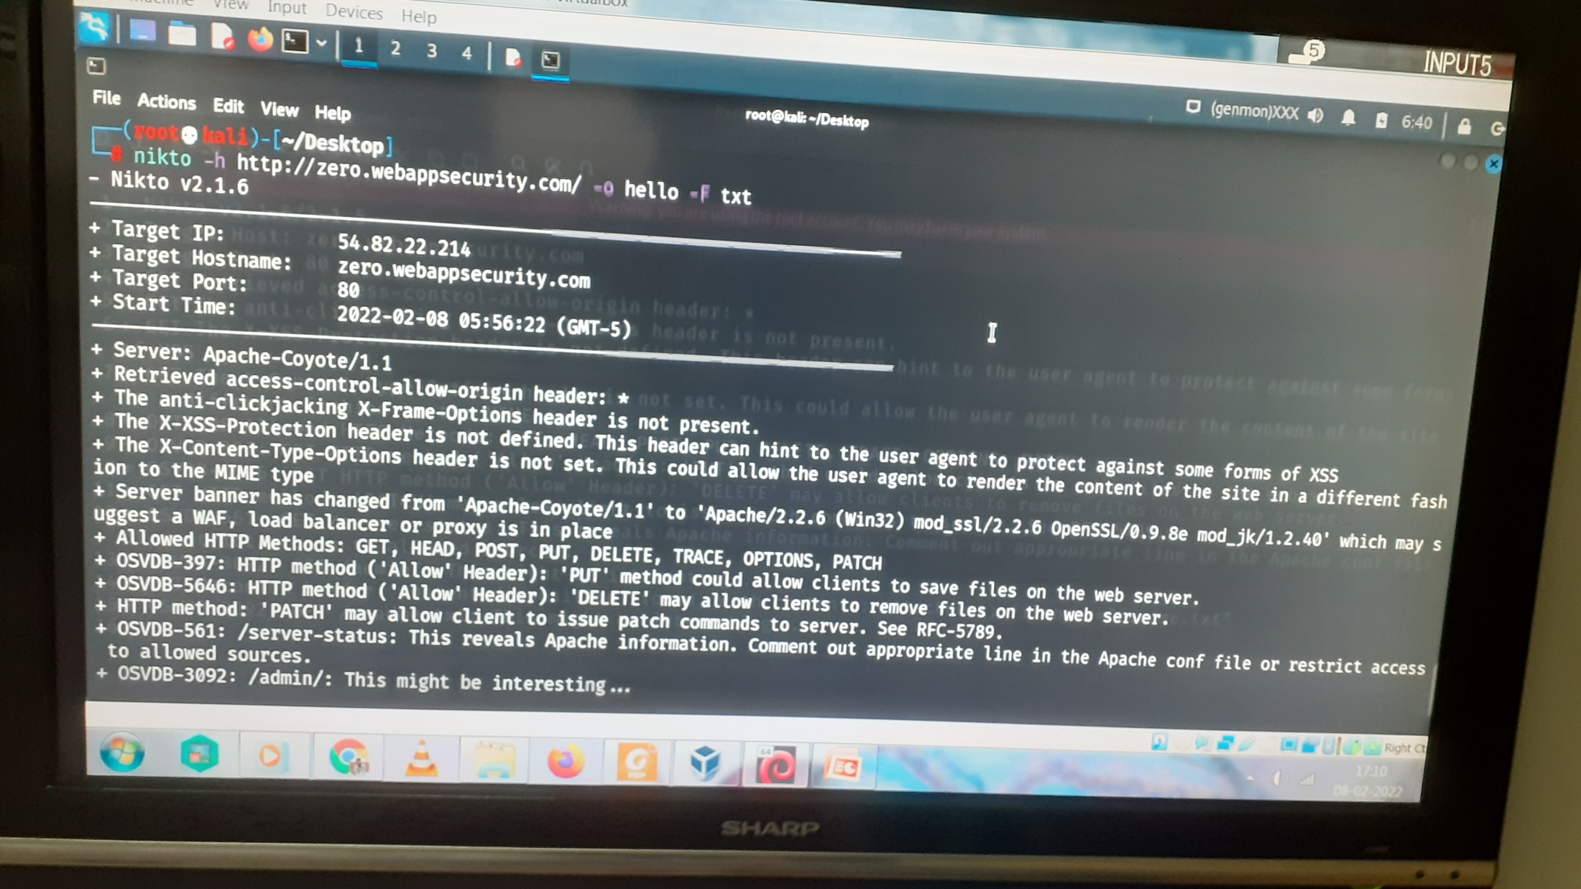
Attached below is the photo of some of the vulnerabilities found on http://zero.webappsecurity.com/

Slide 6
Report:
Title: To find vulnerabilities in a website.
URL: http://zero.webappsecurity.com/ Steps to Reproduce:
Open terminal in Kali Linux.
Write the following command: nikto -h http://zero.webappsecurity.com/ -o test -F txt
-h to define the host, -o to define the name of the output file, -F to define the file type
You will be shown all the vulnerabilities found by nikto tool on the URL you provided.
Impact: The following is the impact of the mentioned vulnerability.
Vulnerability: + GET The X-XSS-Protection header is not defined. This header can hint to the user agent to protect against some forms of XSS
Impact: The server is not configured to return a 'X-XSS-Protection' header which means that any pages on this website could be at risk of a Cross-Site Scripting (XSS) attack.
Mitigation: If legacy browsers support is not needed, it is recommended to use Content-Security-Policy without allowing unsafe-inline scripts instead.

Slide 7
Task 3:
Below is the link to the video stored in my Drive.
https://drive.google.com/file/d/18xKfHfWI2aicfhaYiiCu_JlgLxjLQtKB/view?usp=sharing

Slide 8
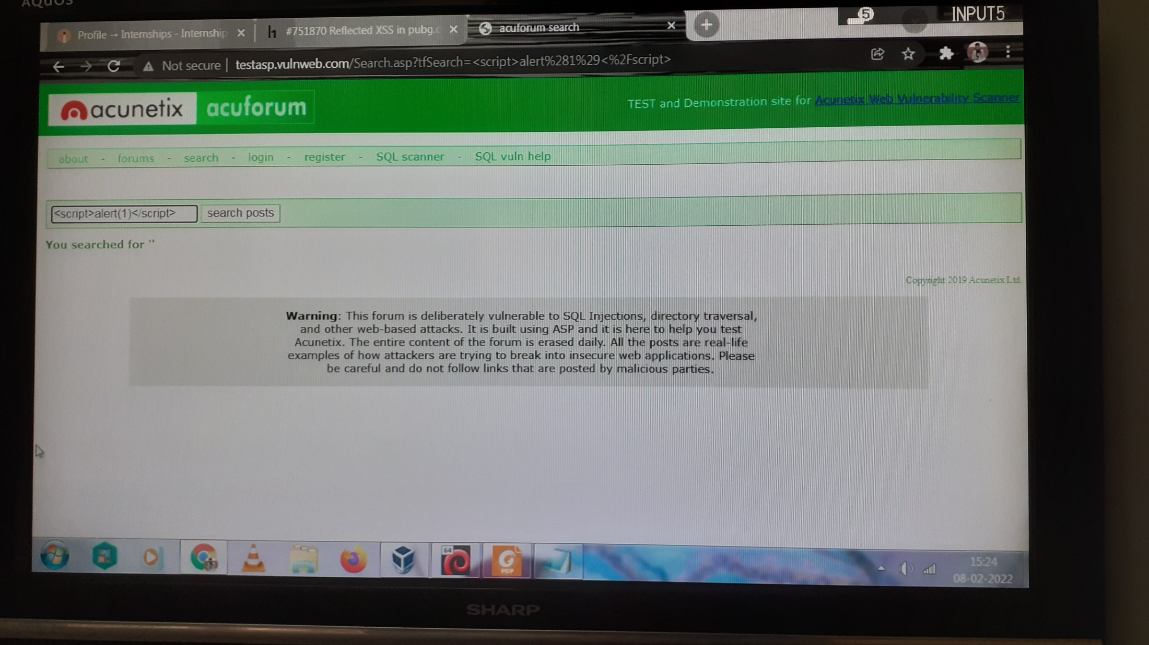
Below attached are the screenshots of the payload I uploaded on the site.

Slide 9
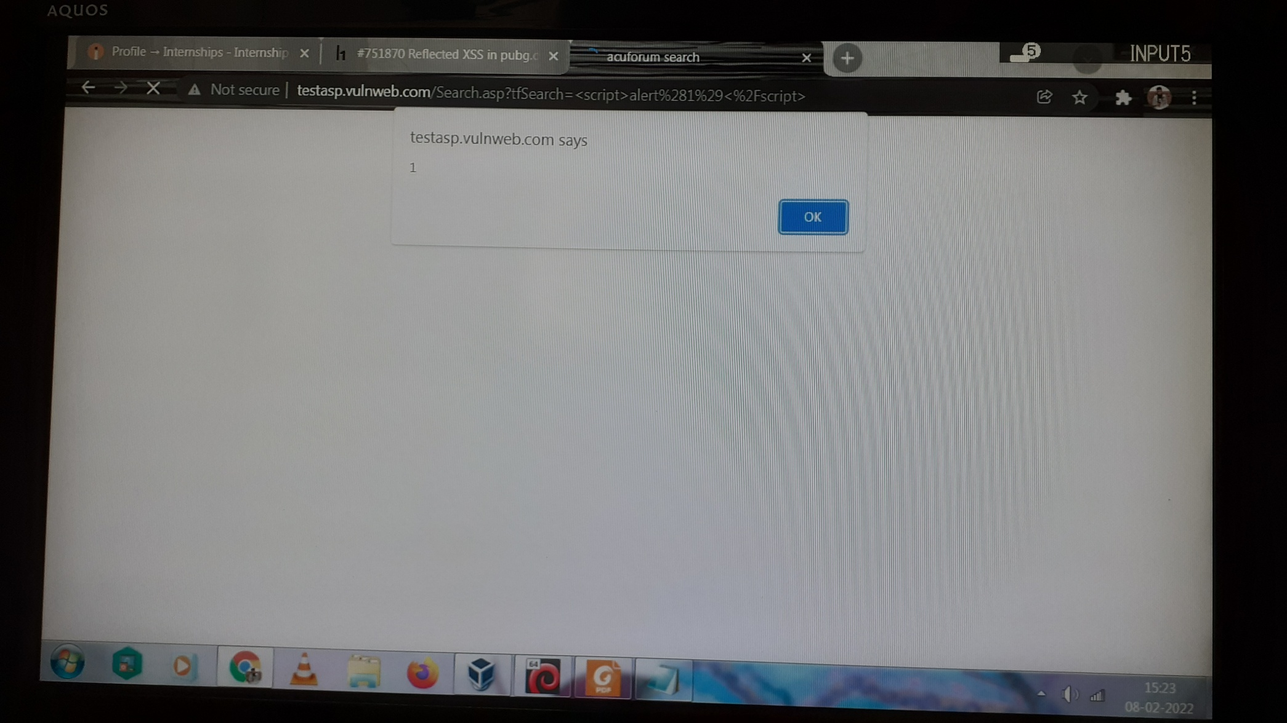

Slide 10
Report:
Title : Cross Site Scripting (XSS).
URL: http://testasp.vulnweb.com/
Steps to Reproduce:
Visit the URL
Click on the search option.
Now, on the input field, write your script code (payload)
This shows that the website is vulnerable for XSS
Impact: XSS can have huge implications for a web application and its users. User accounts can be hijacked, credentials could be stolen, sensitive data could be exfiltrated, and lastly, access to your client computers can be obtained.
Mitigation: A web application firewall (WAF) can be a powerful tool for protecting against XSS attacks. WAFs can filter bots and other malicious activity that may indicate an attack. Attacks can then be blocked before any script is executed.

Slide 11
Thank You!

